Slide 1
E-Farming
Codezillas
University of Moratuwa

Slide 2
Have you ever observed this world for a few minutes?
E-Farming

Slide 3

E-Farming

Slide 4
Why are we running?
Most of us are only for food.
Some of us mostly for food.
E-Farming

Slide 5
Food is our basic need.
And agriculture is the only way to make food.
Therefore, developing agriculture is our responsibility.
E-Farming

Slide 6
Agriculture face a lot of problems and challenges because of
Population
Industrialization and climate changes
Education based lifestyle
E-Farming

Slide 7

E-Farming

Slide 8
E-Farming
E-Farming

Slide 9
Introduction
The biggest problem in cultivation is irrigation.
Also included some other technologies.
E-Farming

Slide 10
Smart Irrigation
By analyzing the soil, our solution suggests the moisture and pH levels needed for each types of crops.
Control irrigation from any where at any time.
Uses the OpenWeatherMap’s weather API and Google Maps API.
E-Farming

Slide 11
Intelligent farming
Different phases of a plants lifecycle are available in our servers.
Hence, our device can predict the period in which the field needs attention, like fertilization period.
This makes farmers life much easier and saves the time.
E-Farming

Slide 12
Devices collect the data from sensors and sends it to the server.
User friendly results.
They can visit our website and send commands.
Simply send an SMS using Twillo API.
SMS feature is mainly for the farmers in rural areas who don’t have access to the internet or smartphones.
E-Farming

Slide 13
Implementation
Our device consist of …..
Solenoid valve to control water flow,
GSM shield to communicate with server,
Temperature, Humidity and Light Level sensors.
And powered by a Solar cell.
E-Farming

Slide 14
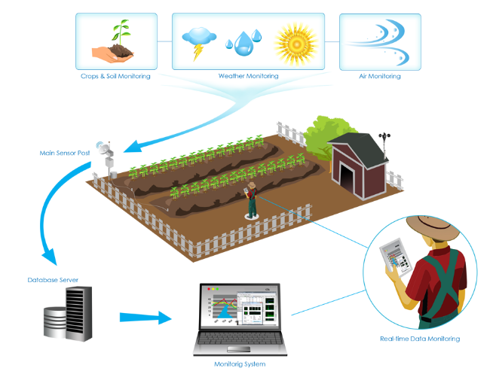
Architectural diagram

Slide 15
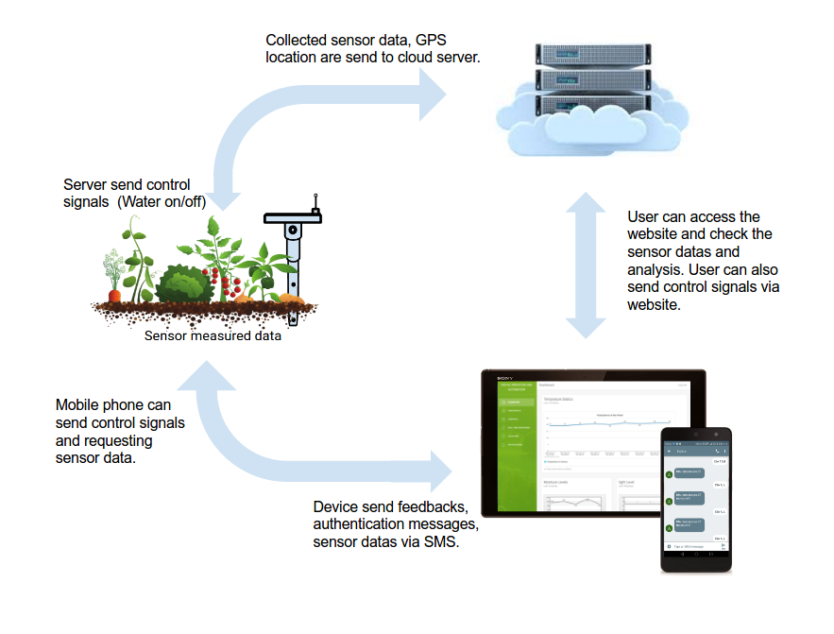

Slide 16
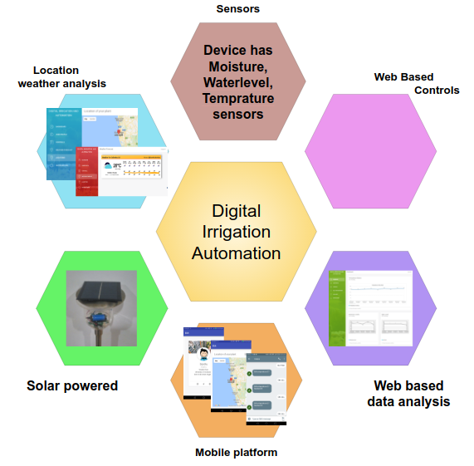
Concept diagram of e-Farming
E-Farming
E-Farming

Slide 17
We have discussed with farmers about the e-Farming concept.
e-Farming concept received favorable feedback from users.
What they have to do is just to install our device.
E-Farming

Slide 18
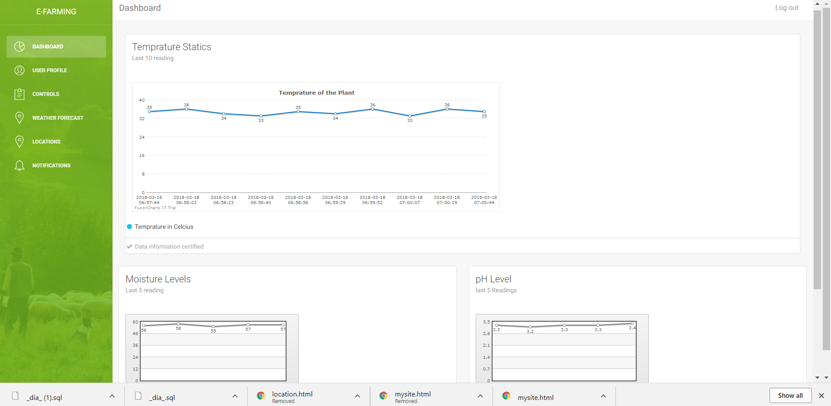
Website
E-Farming

Slide 19
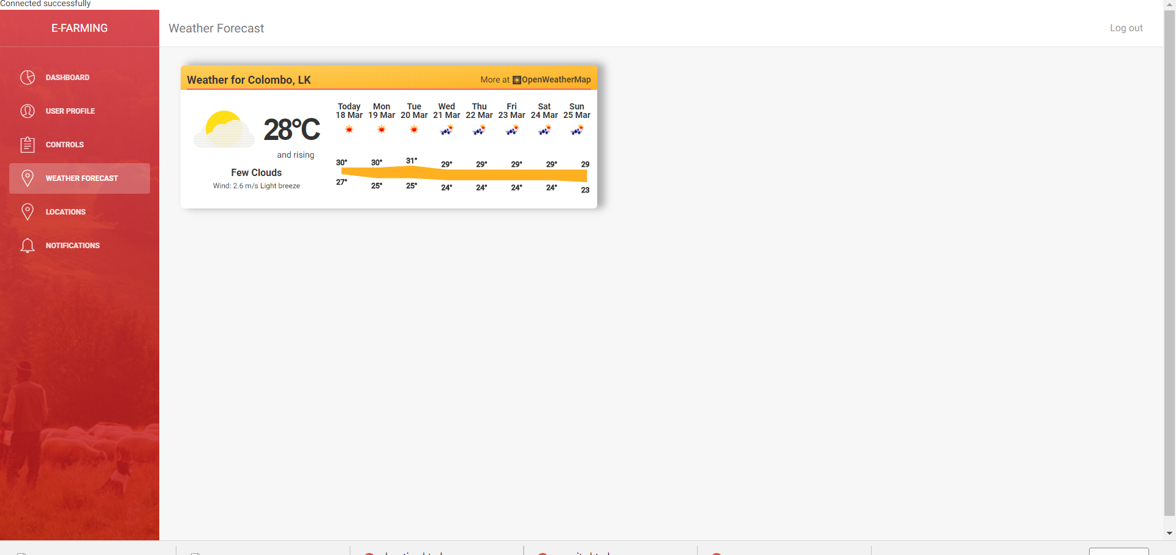
Website

Slide 20
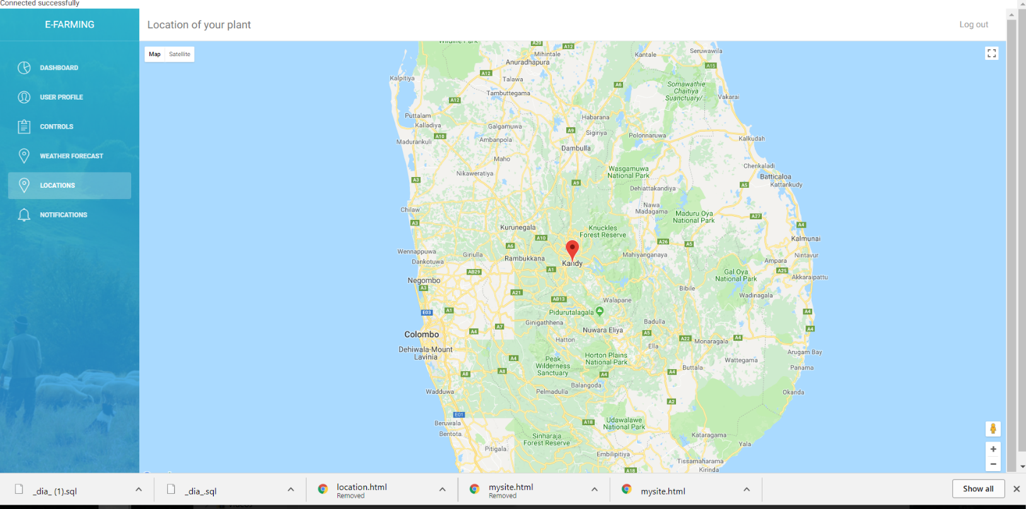
Website

Slide 21
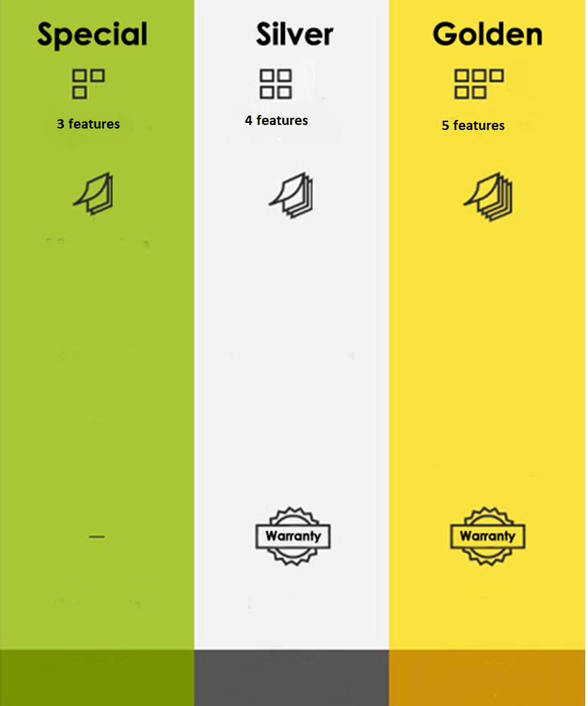
300 m²
Rs 14,999
SMS
USSD
Predictions using Weather stations
Rs 100 /month
Rs 19,999
SMS
USSD
Predictions using Weather stations
Automation
1 year
Rs 300 /month
Rs 24,999
SMS
USSD
Predictions using Weather stations
Automation
App
2 year
Rs 500 /month
E-Farming

Slide 22
Conclusions
We are in the starting stage of implementation.
We hope it will be a agricultural revolution.
It will encourage youngsters to do agriculture.
Maximize their benefit.
E-Farming

